Slide 1
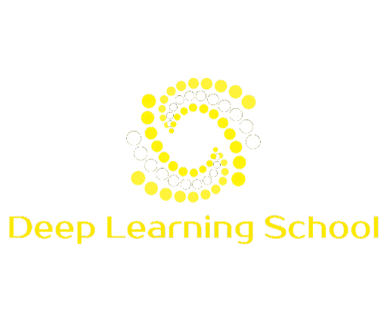
Lecture 2
Linear Algebra
Nadya Zueva

Slide 2
Lecture plan
Recap of linear objects
NumPy intro
Integration with ML

Slide 3
Linear Objects
Recap

Slide 4
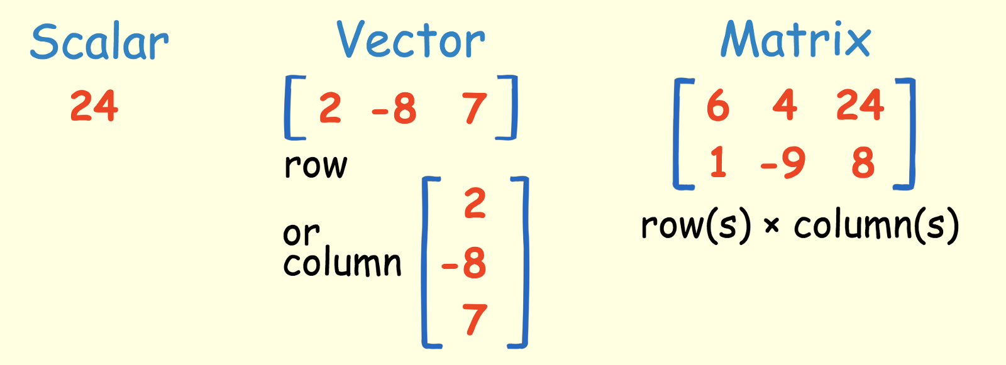
https://towardsdatascience.com/linear-algebra-for-deep-learning-f21d7e7d7f23

Slide 5
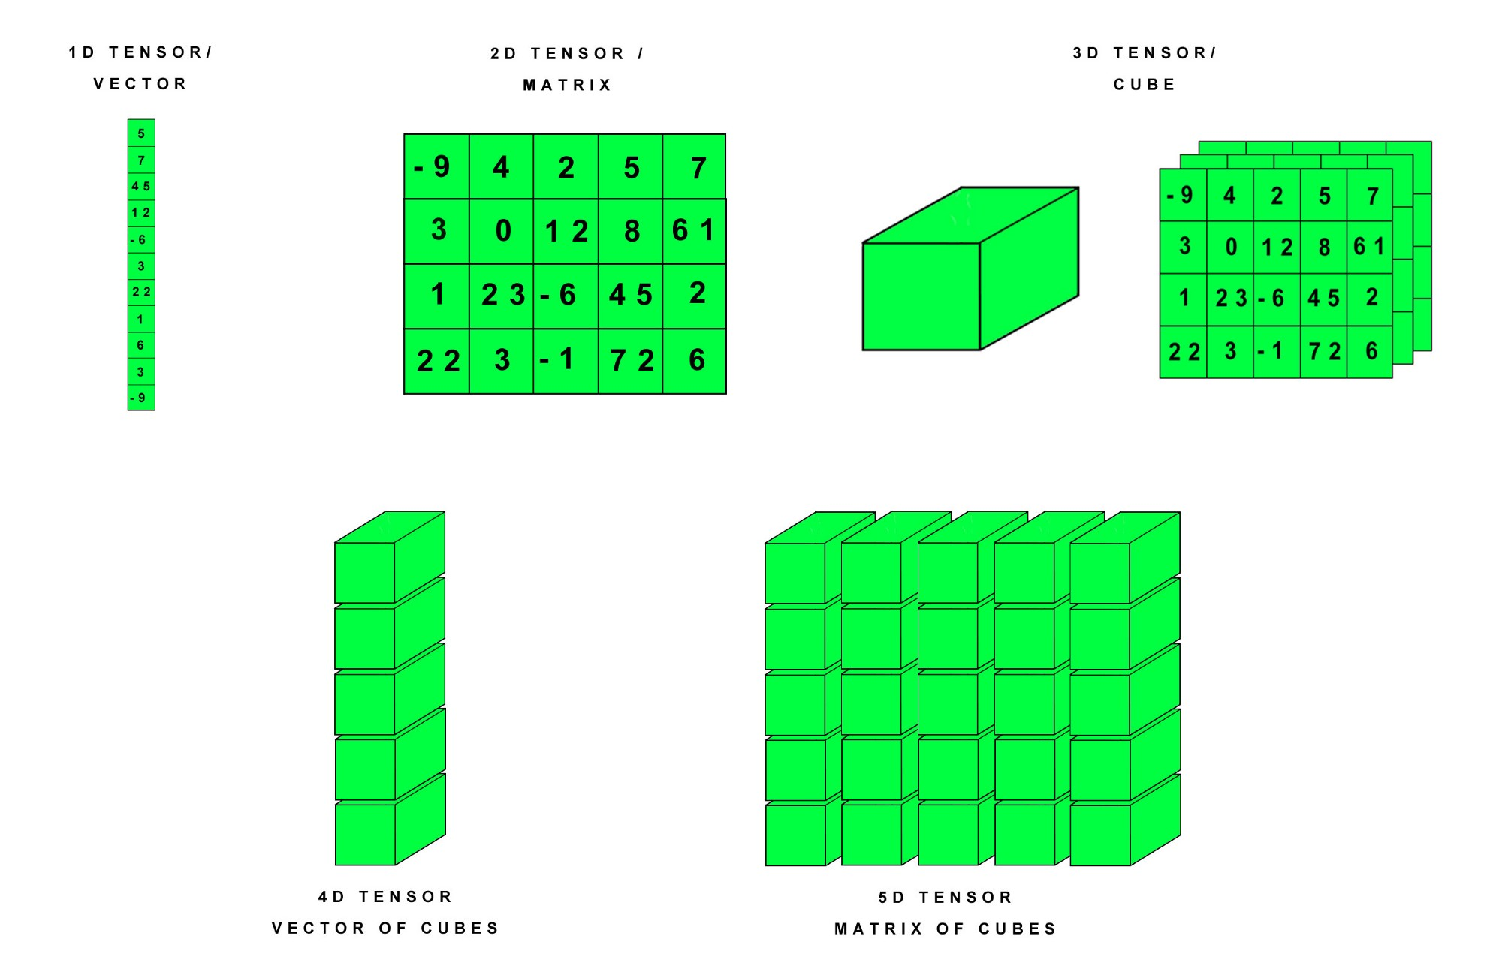
https://hackernoon.com/learning-ai-if-you-suck-at-math-p4-tensors-illustrated-with-cats-27f0002c9b32

Slide 6
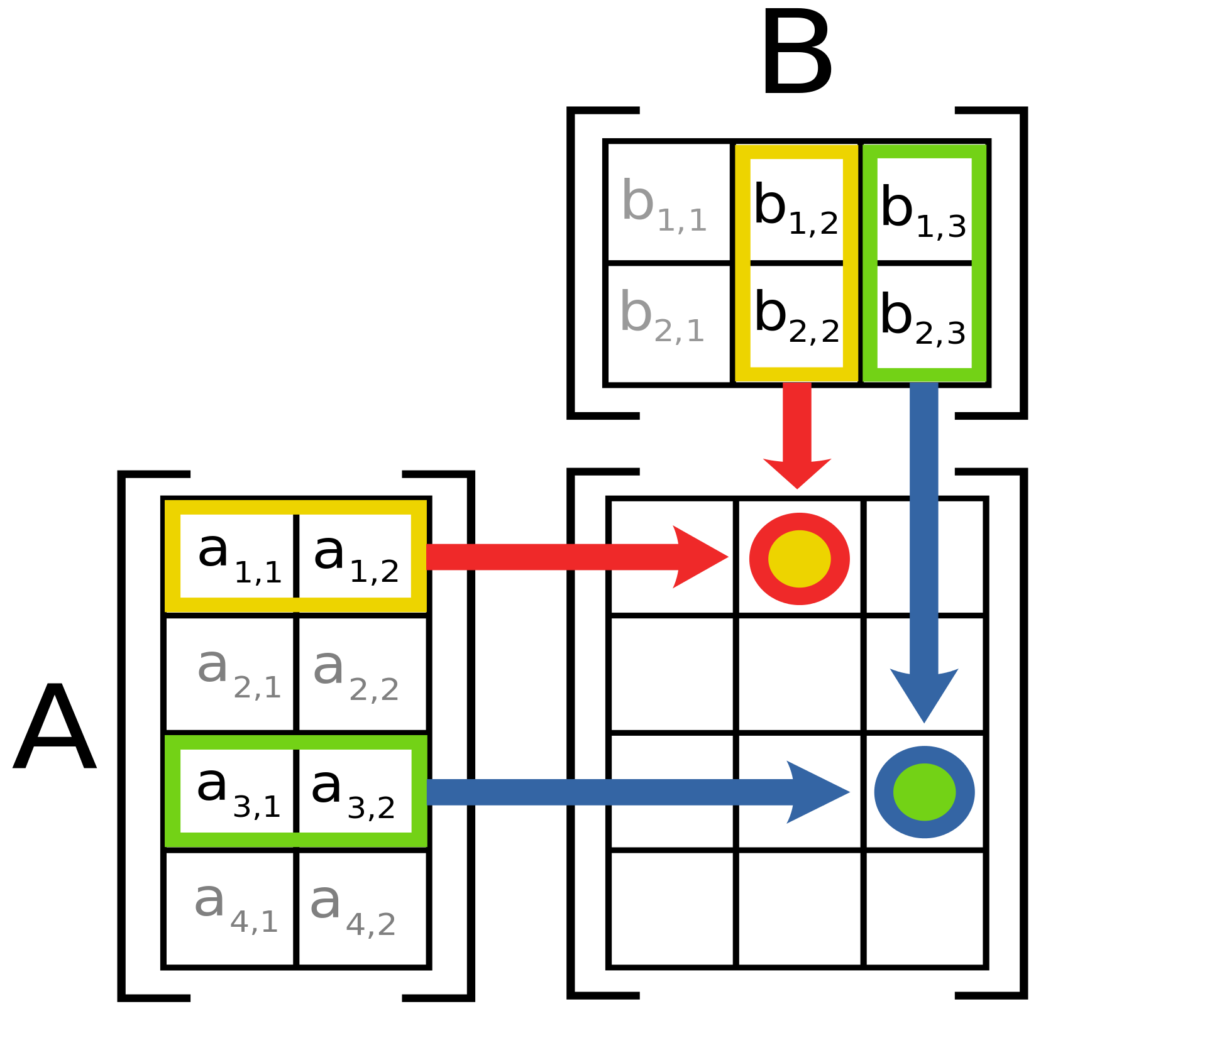
A@B
https://hackernoon.com/learning-ai-if-you-suck-at-math-p4-tensors-illustrated-with-cats-27f0002c9b32

Slide 7
What is NumPy?

Slide 8

NumPy is the fundamental package for scientific computing with Python. It contains among other things:
a powerful N-dimensional array object
sophisticated (broadcasting) functions
tools for integrating C/C++ and Fortran code
useful linear algebra, Fourier transform, and random number capabilities
CPU only :(

Slide 9
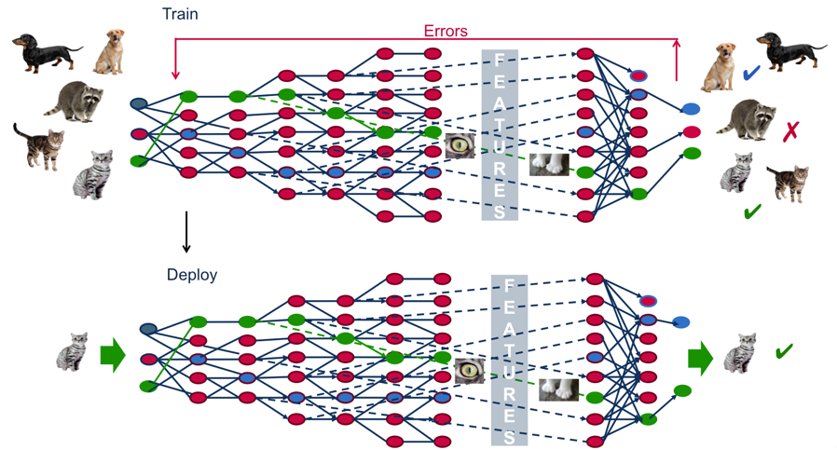

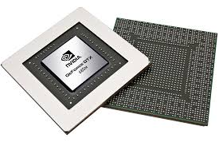
tensors!

Slide 10
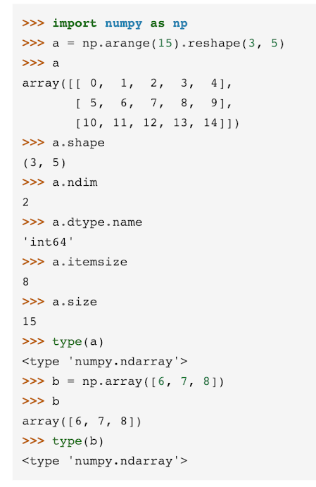
https://docs.scipy.org

Slide 11
include modules
with short name
https://docs.scipy.org

Slide 12
defining array of 15 items and reshaping into matrix 3x5
https://docs.scipy.org

Slide 13
getting info about array a
https://docs.scipy.org

Slide 14
operations with lists are supported
https://docs.scipy.org

Slide 15
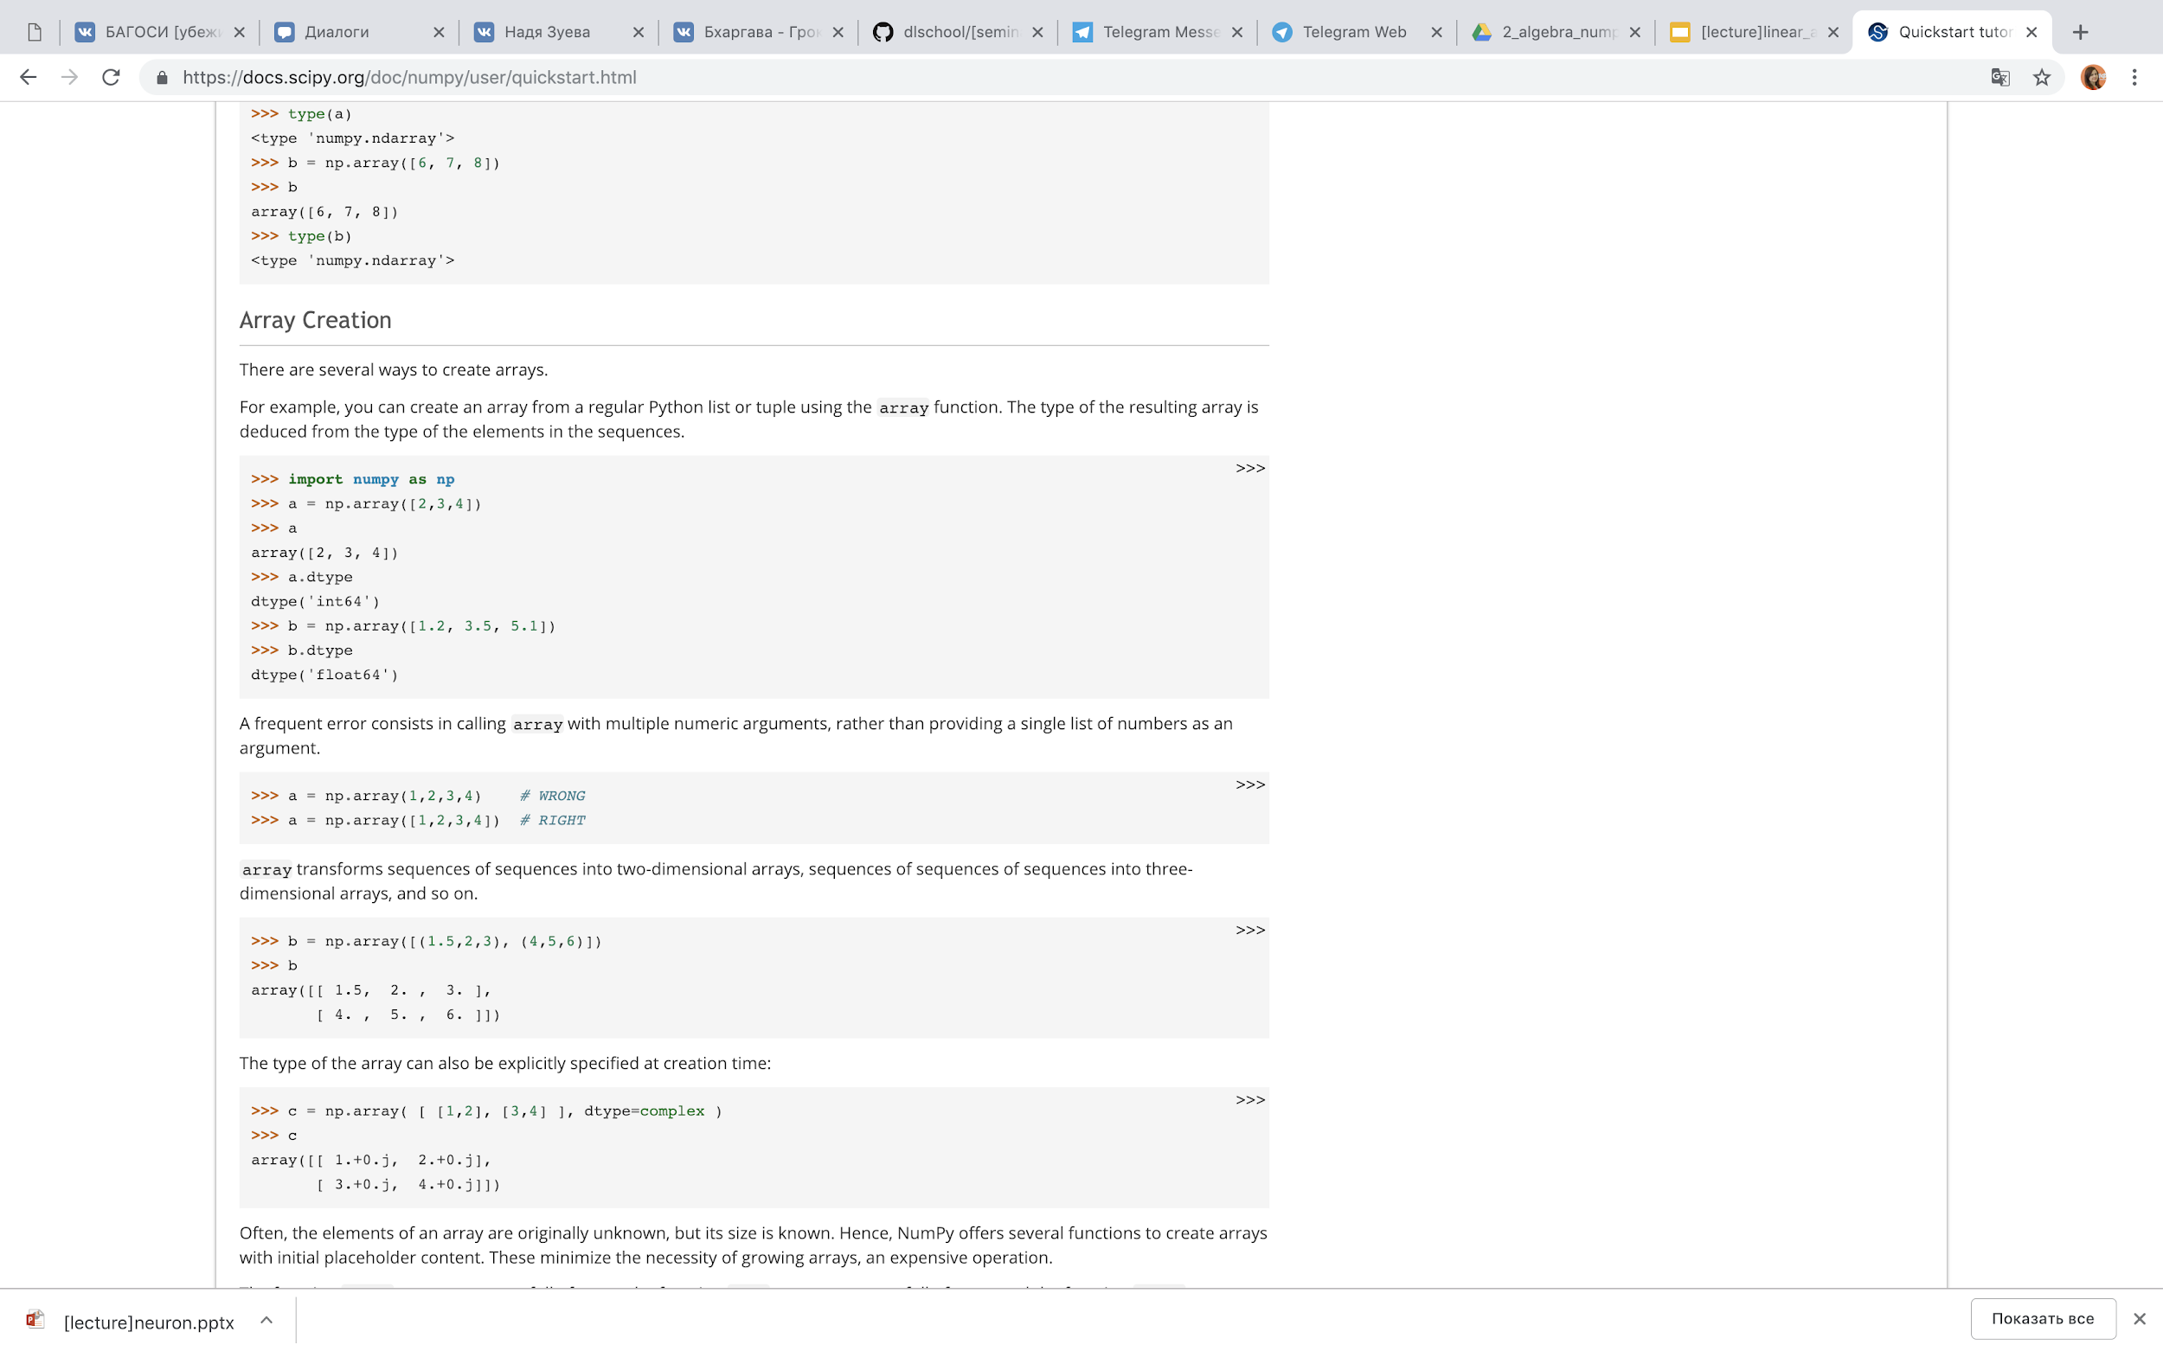
Array creation
np.array from Python list

Slide 16
Be careful!

Slide 17
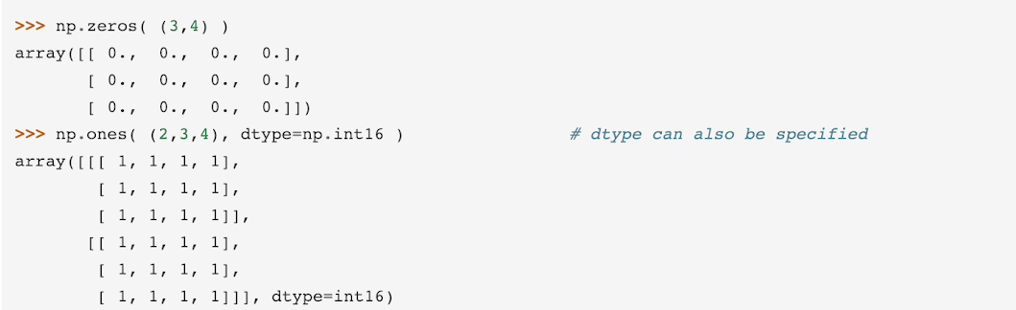
Array creation

Slide 18
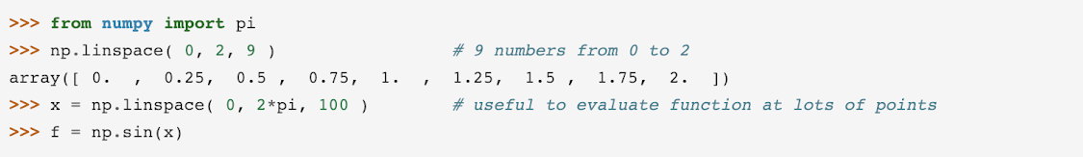
Array creation
constants
functions

Slide 19
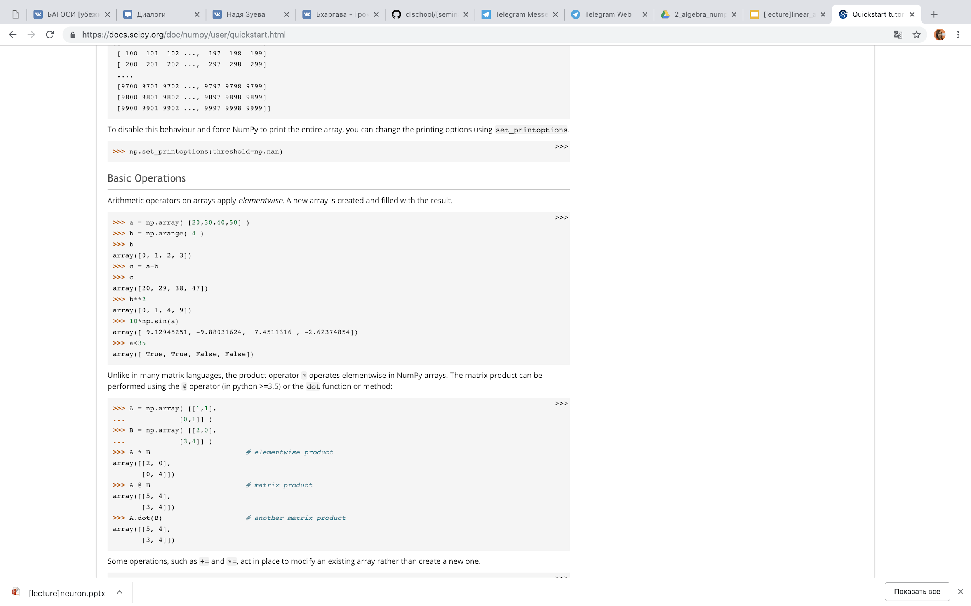
Basic operations

Slide 20
Basic operations with matrices

Slide 21
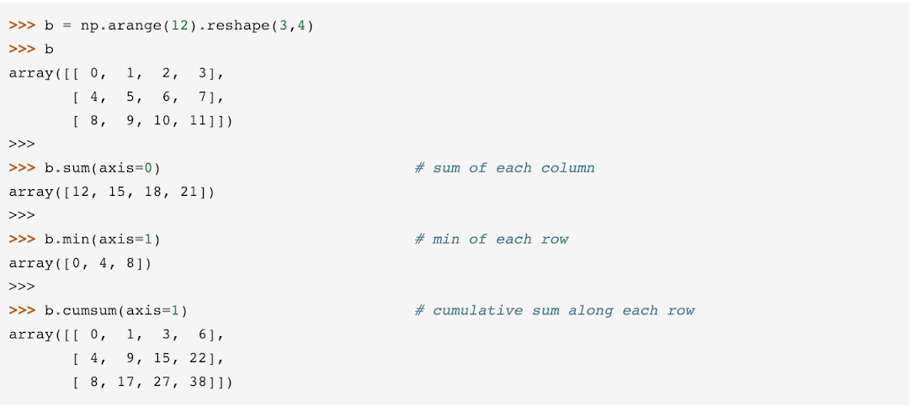
Basic operations with arrays

Slide 22
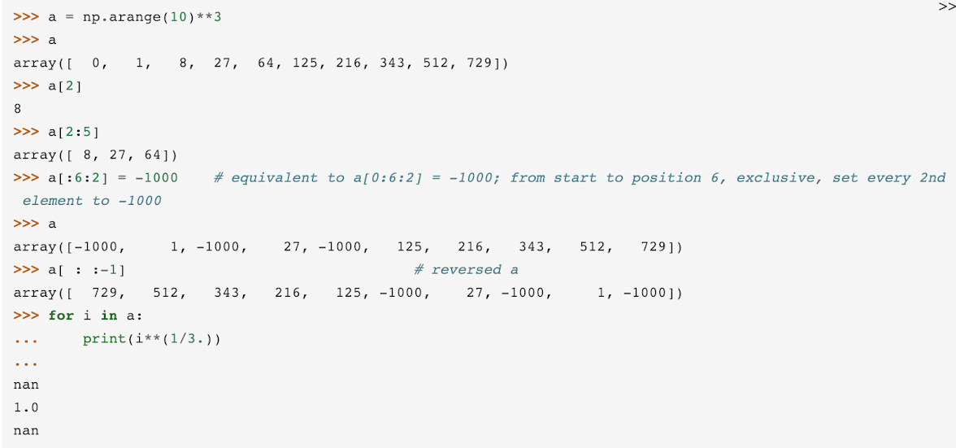
Indexing, slicing, iterating
print(np.fromfunction (f, a))

Slide 23
Why do we care?

Slide 24
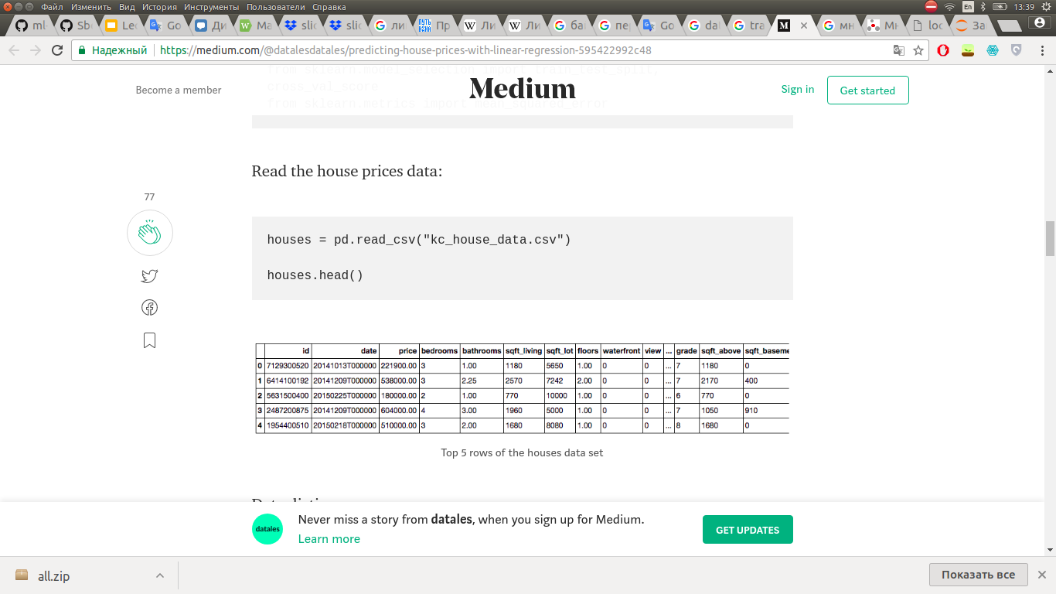
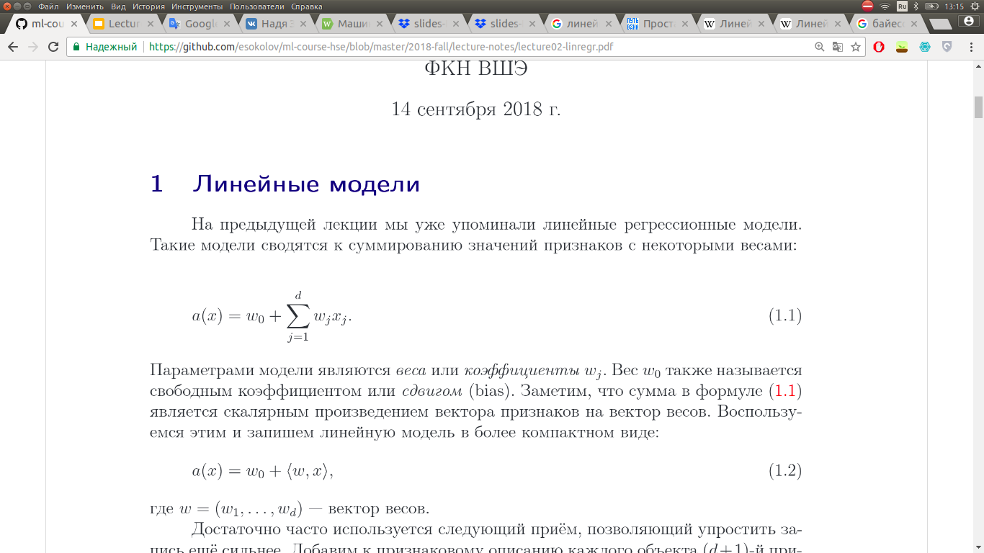
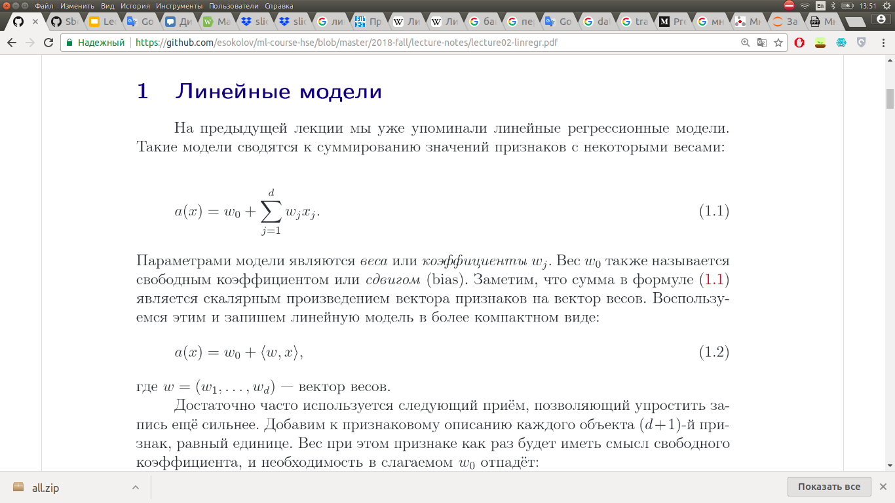
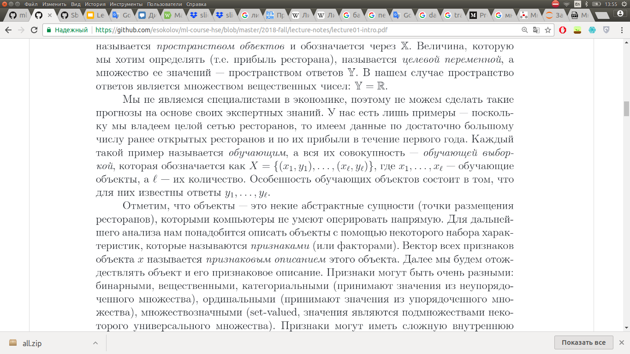


*

Slide 25
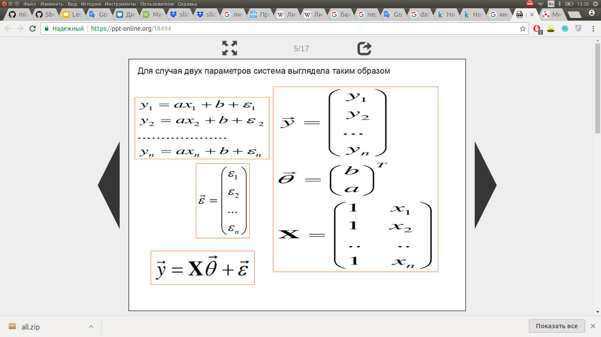
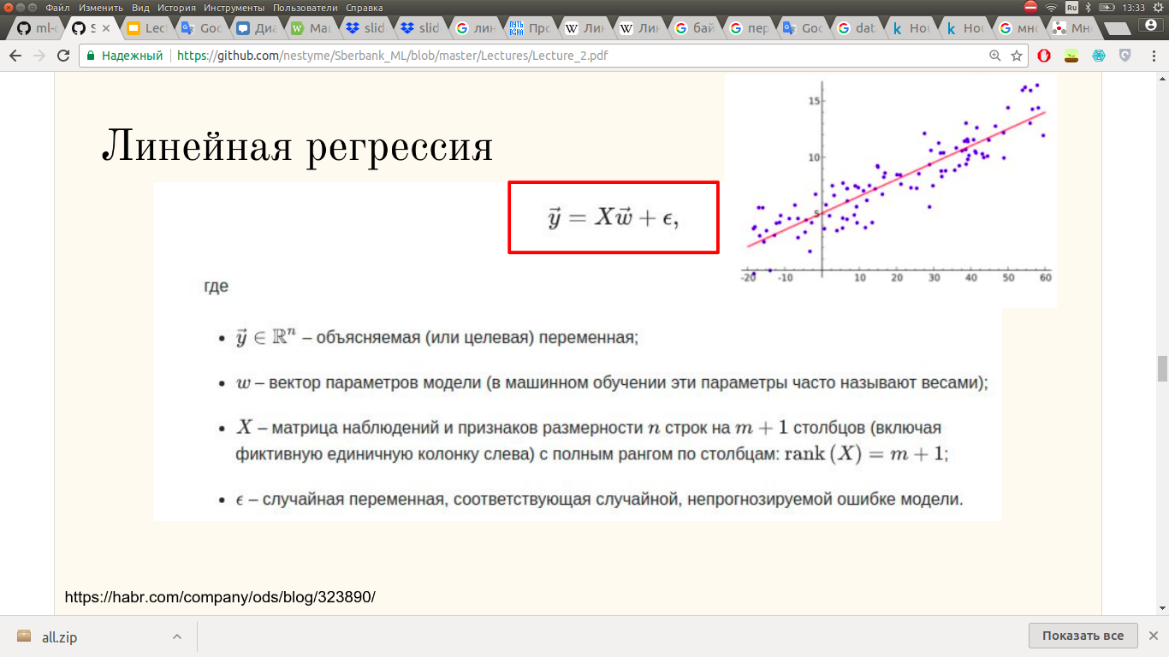
Matrix form

Slide 26
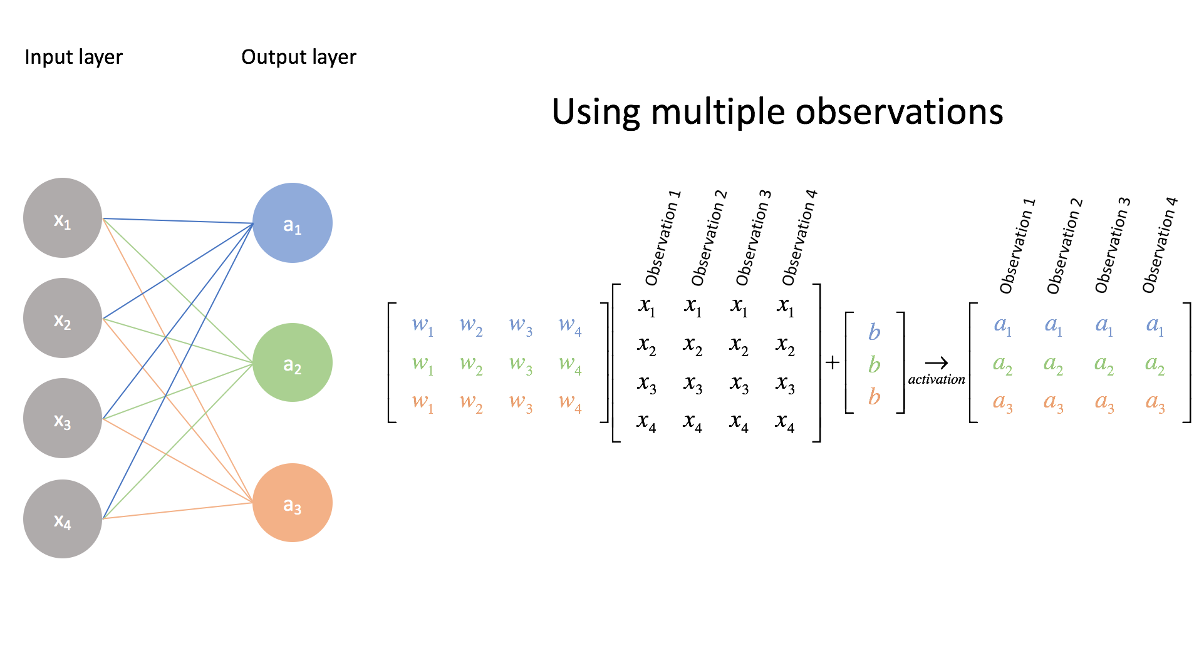
network params
https://www.jeremyjordan.me/intro-to-neural-networks/

Slide 27
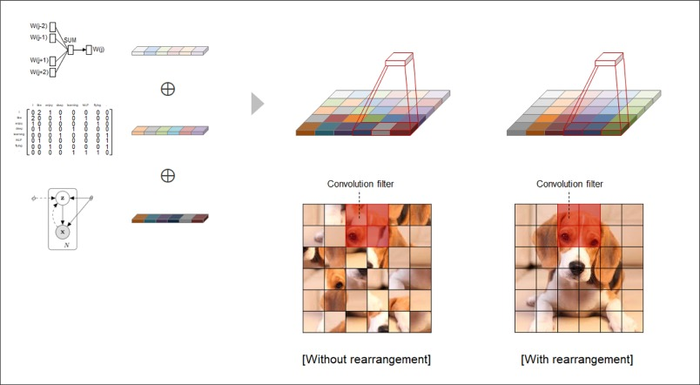
https://www.sciencedirect.com/science/article/pii/S0925231218308464

Slide 28

Conclusion
NumPy is the fundamental package for scientific computing with Python
We use GPU for games and for Deep Learning Research for the same reasons
Deep Learning = tensors + operations with tensors
https://becominghuman.ai/cheat-sheets-for-ai-neural-networks-machine-learning-deep-learning-big-data-678c51b4b463

